Slide 1
LA ENTRADA DEL MAR CONDOMINIUM ASSOCIATION, INC.
NOTICE OF BOARD OF DIRECTORS
MEETING
Date: Wednesday, June 13, 2022nd,
Time: 6:30pm Meeting
Location: 1300 Seaway Dr., Clubhouse
Call to order
Pledge of Allegiance
Roll Call
Treasurer’s Report
Approve 4.08.22 Meeting Minutes
AGENDA
Old Business
Dock Update
Ice Machine update
Grill Update
Parking Lot update
New Business
1. Pool Contract
2. 2021 Annual Financial Report (audit/review)
3. La Entrada Rules Book.
4. Guest registration
General comments (3 minutes per member)
Adjournment

Slide 2
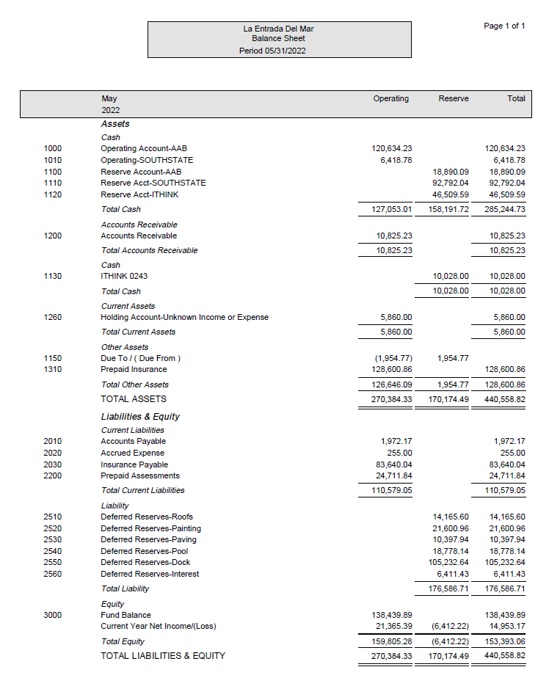

Slide 3
Old Business

Slide 4
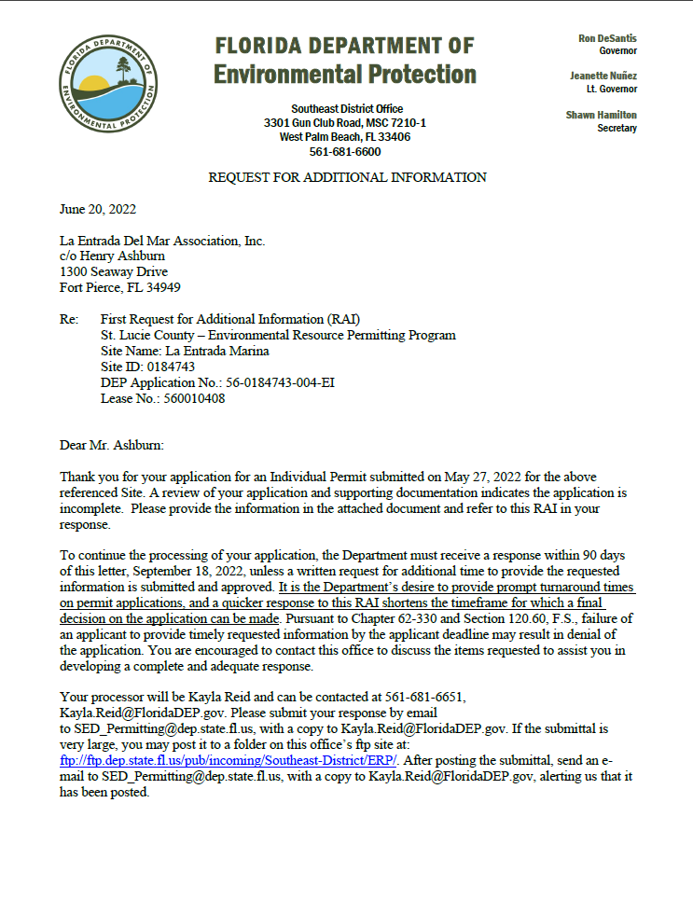
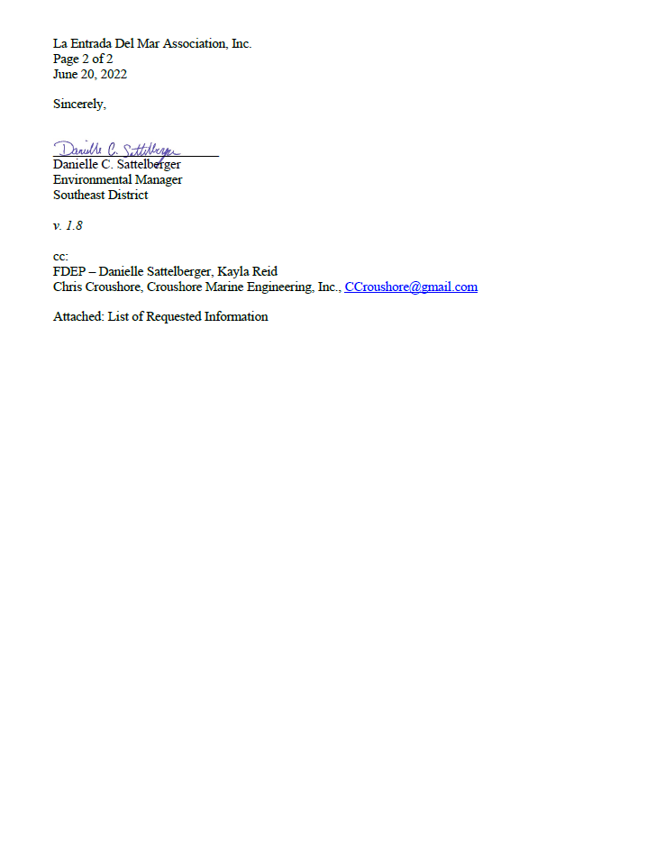
1.

Slide 5
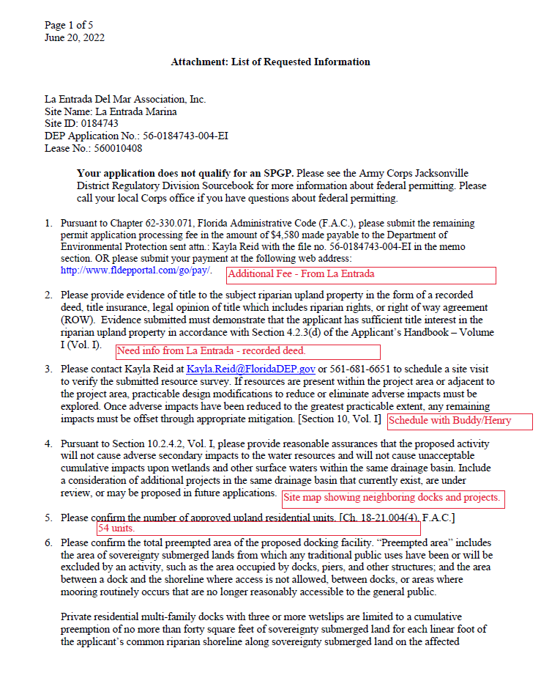
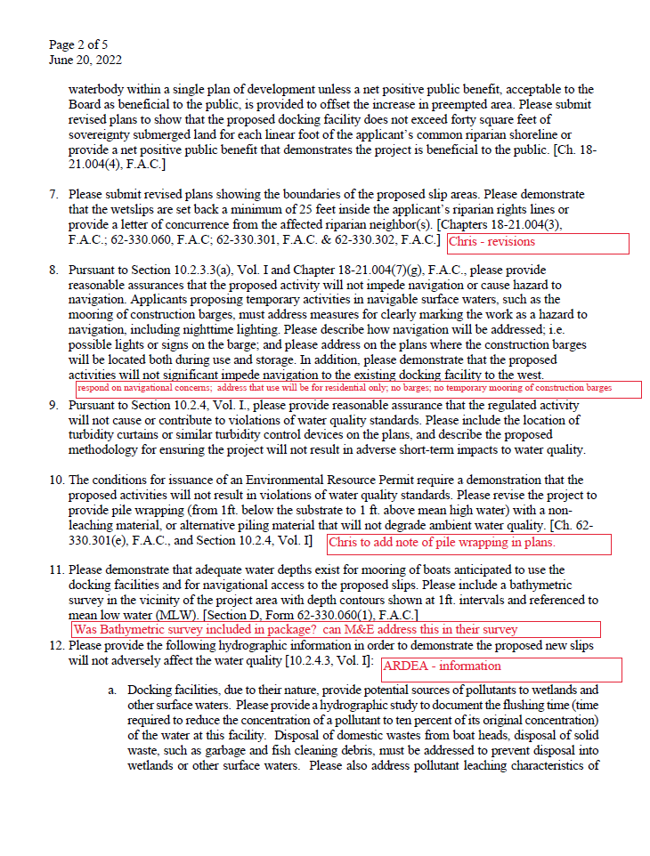

Slide 6
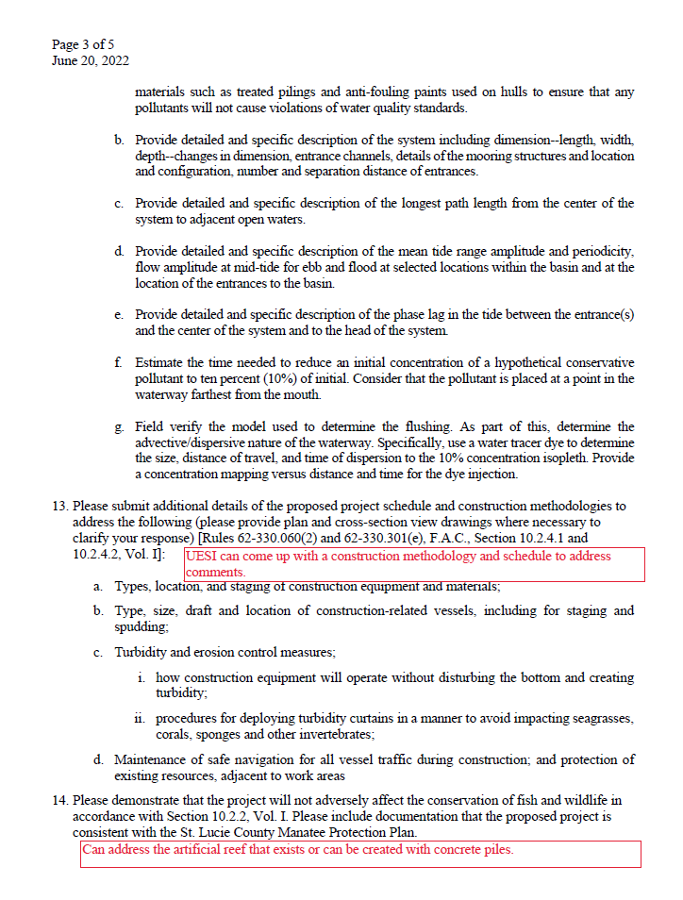
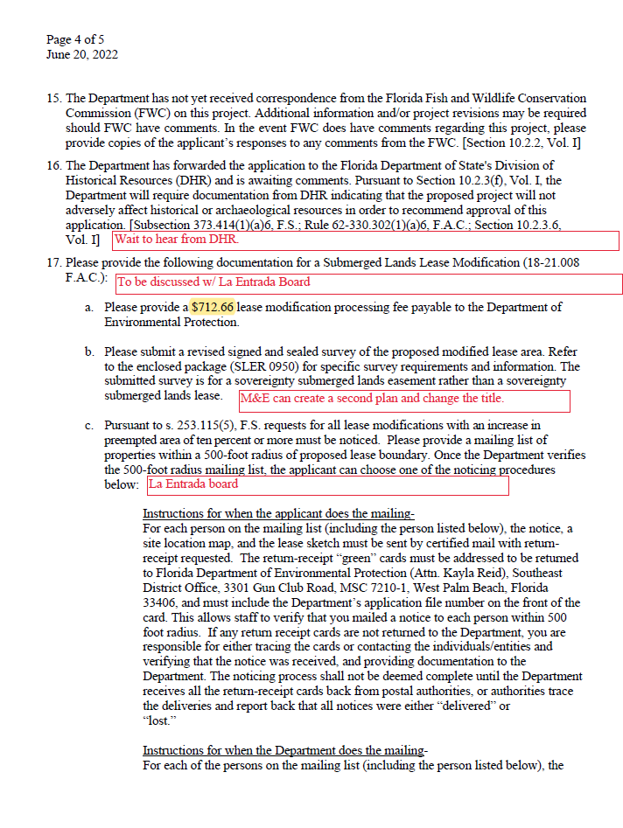

Slide 7
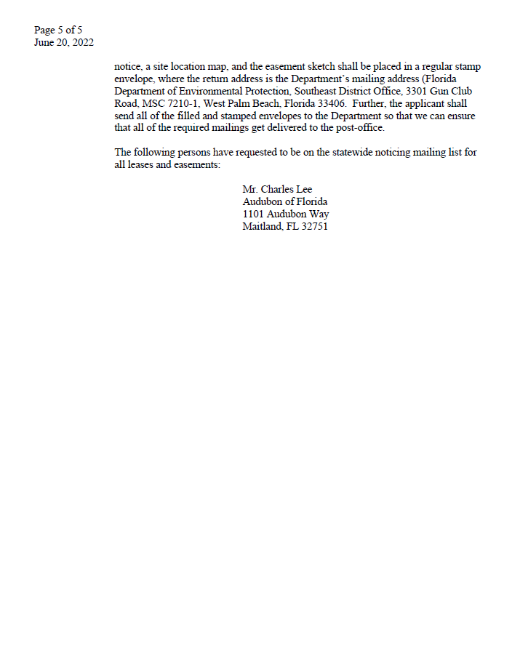

Slide 8
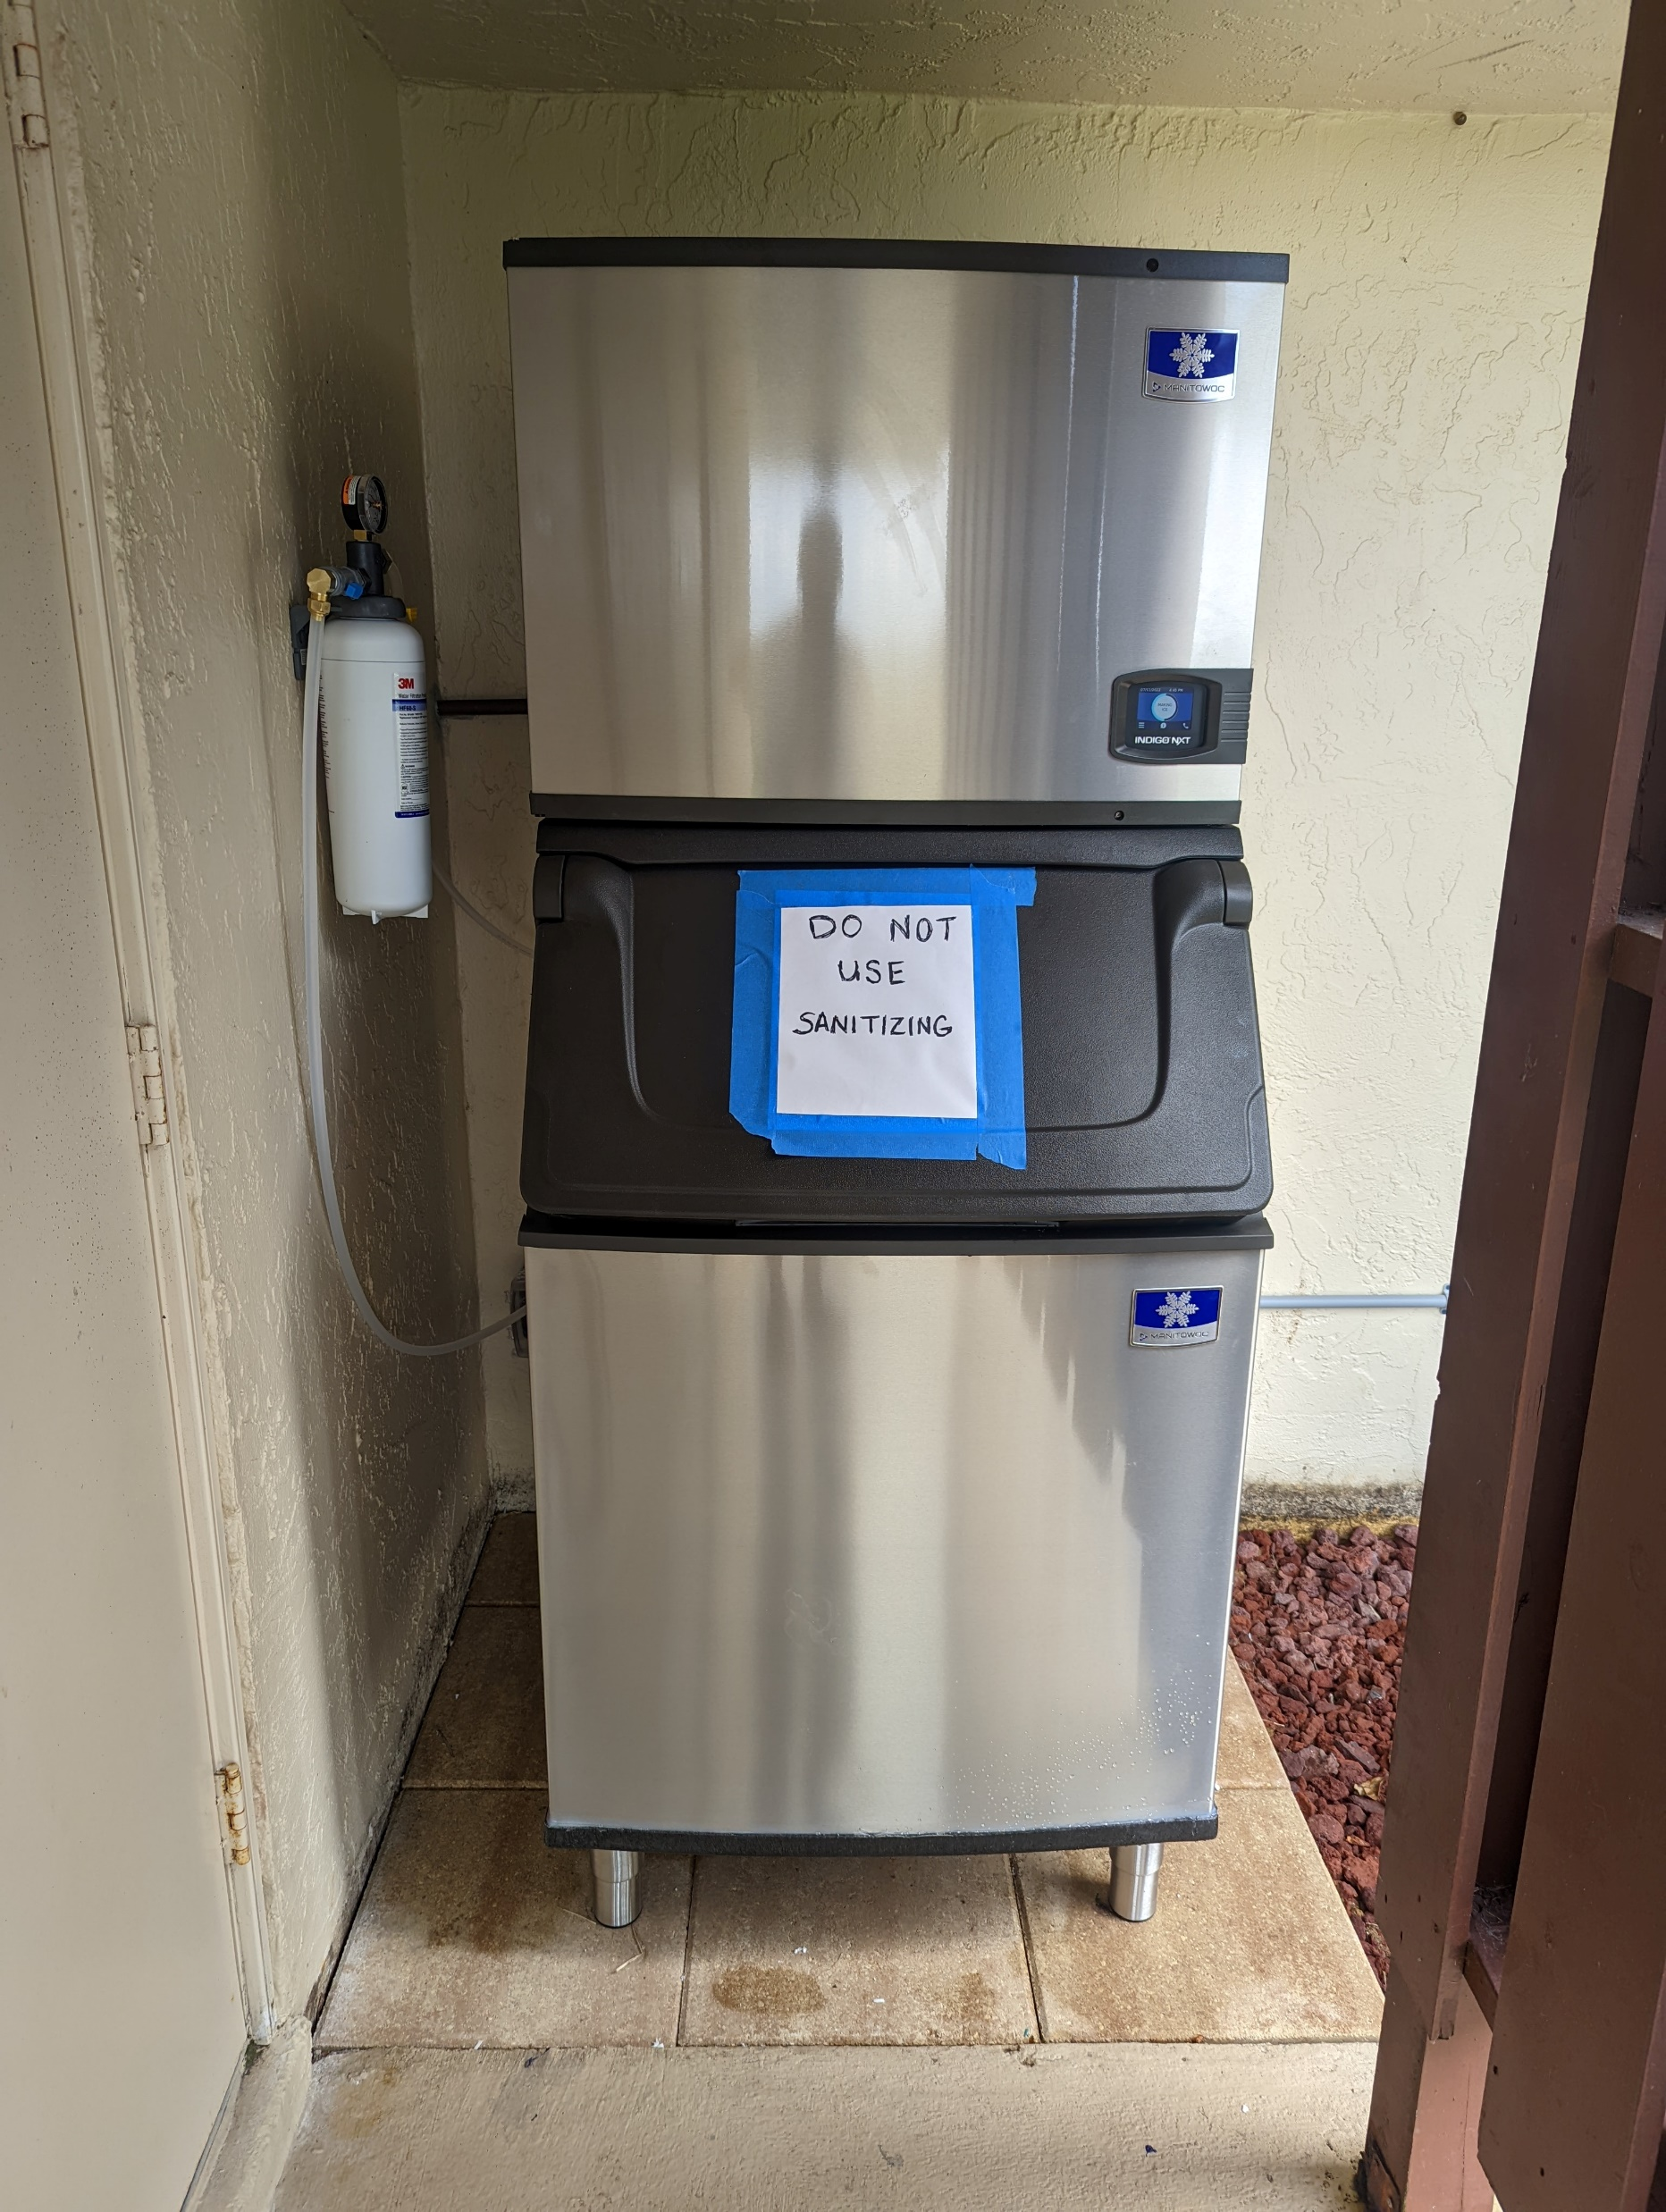
2.
It’s now ready for use! Thanks to Joe Smith and all those who donated.

Slide 9
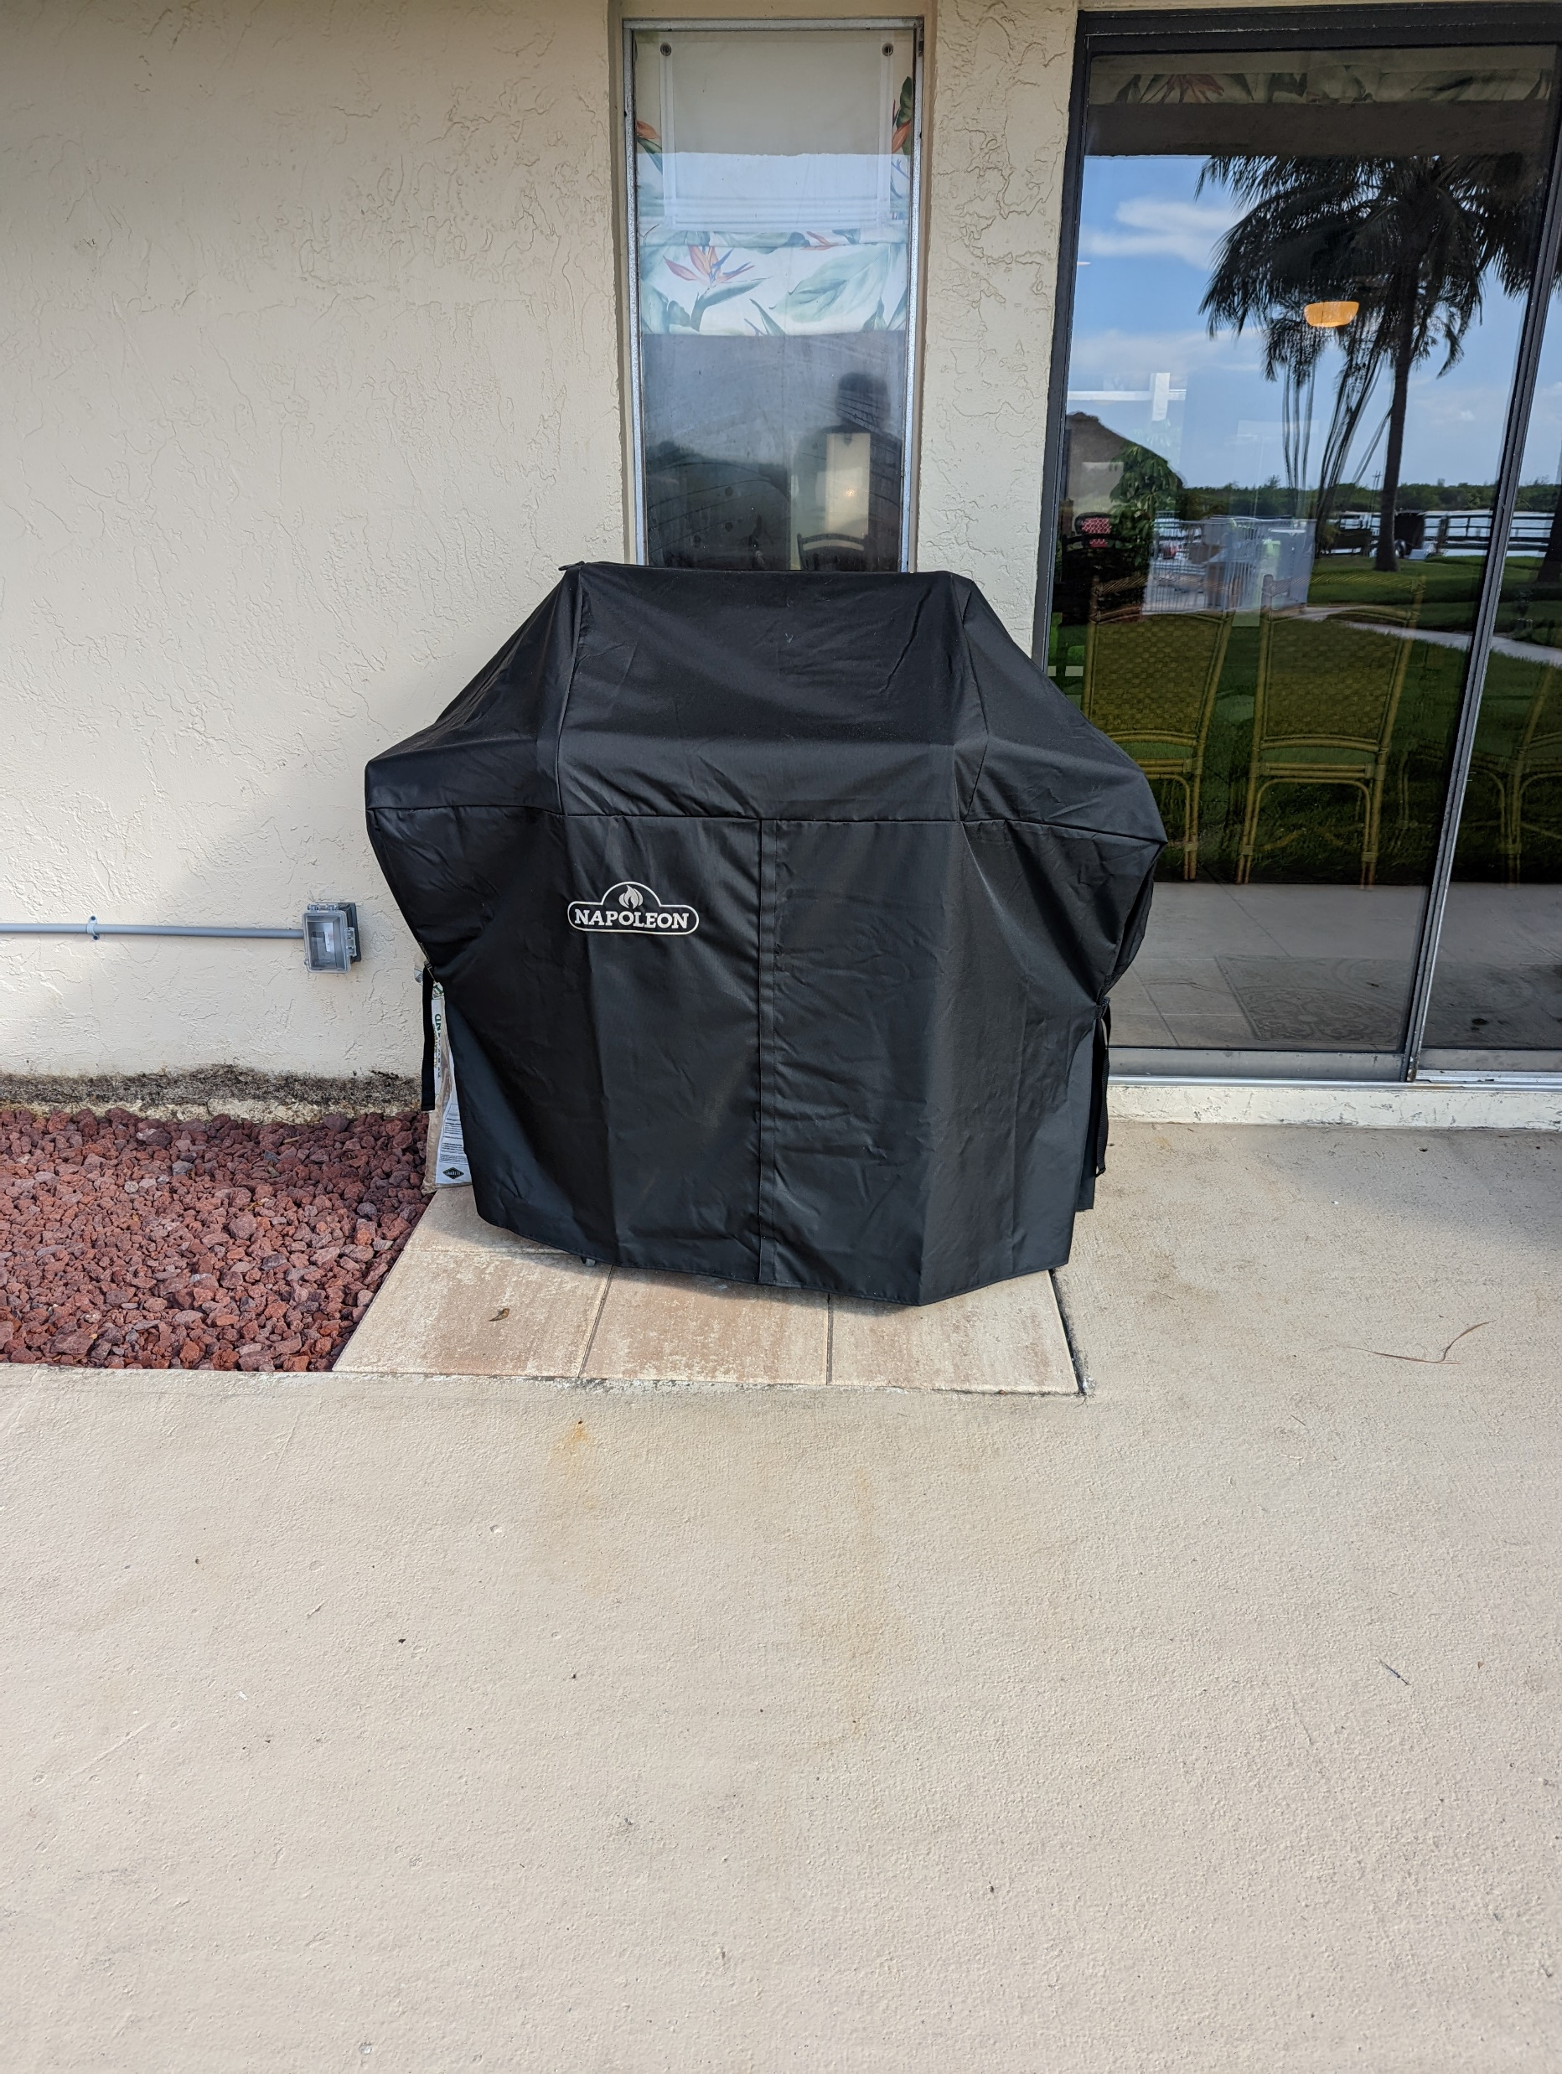
3.
It’s now ready for use! Thanks to Skip Farinhas and all those who donated.

Slide 10
4.
The Parking Lot work was completed last month. We’ve received numerous complements saying that they look much better with easy to read numbers.
We did receive one comment calling the new system “weird” and asking if the “mistake will be rectified.”
For those owners and renters with large trucks, please take advantage of the designated truck parking spots when you have more than one vehicle.

Slide 11
New Business

Slide 12
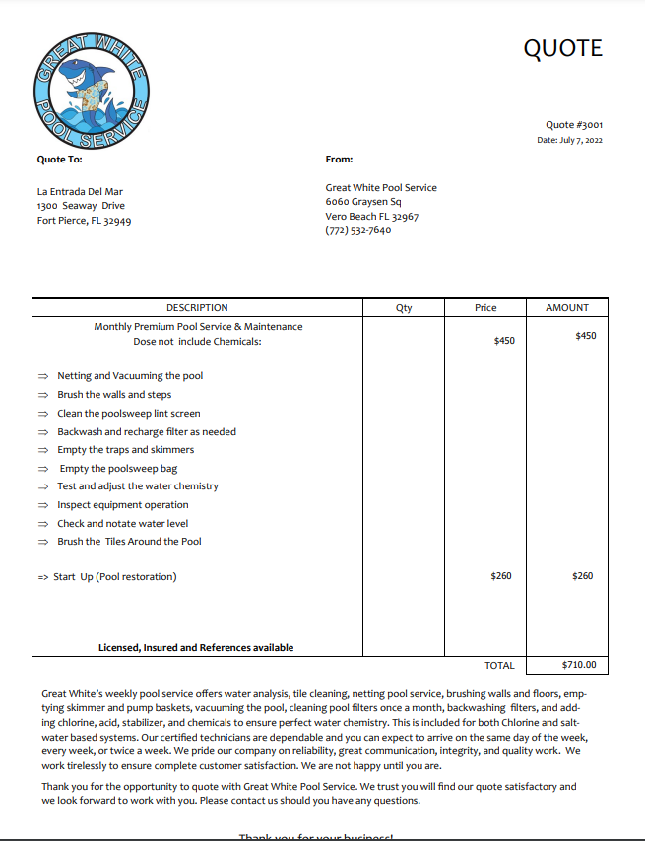
1.

Slide 13
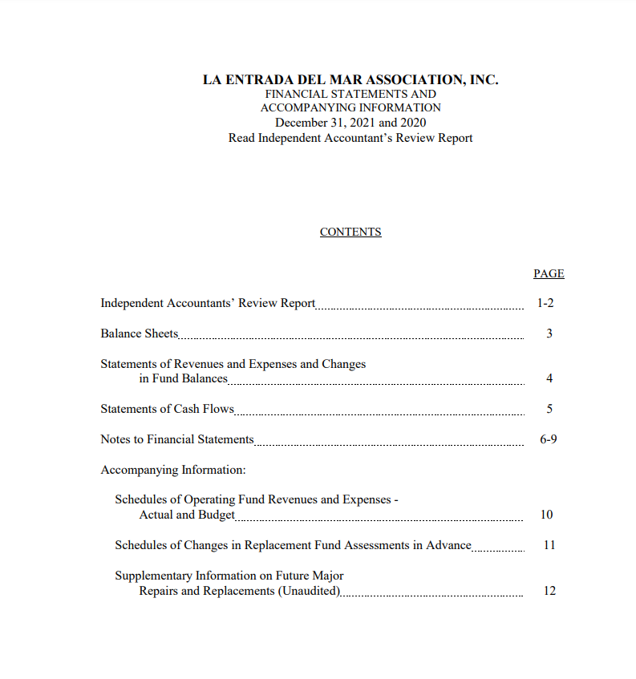
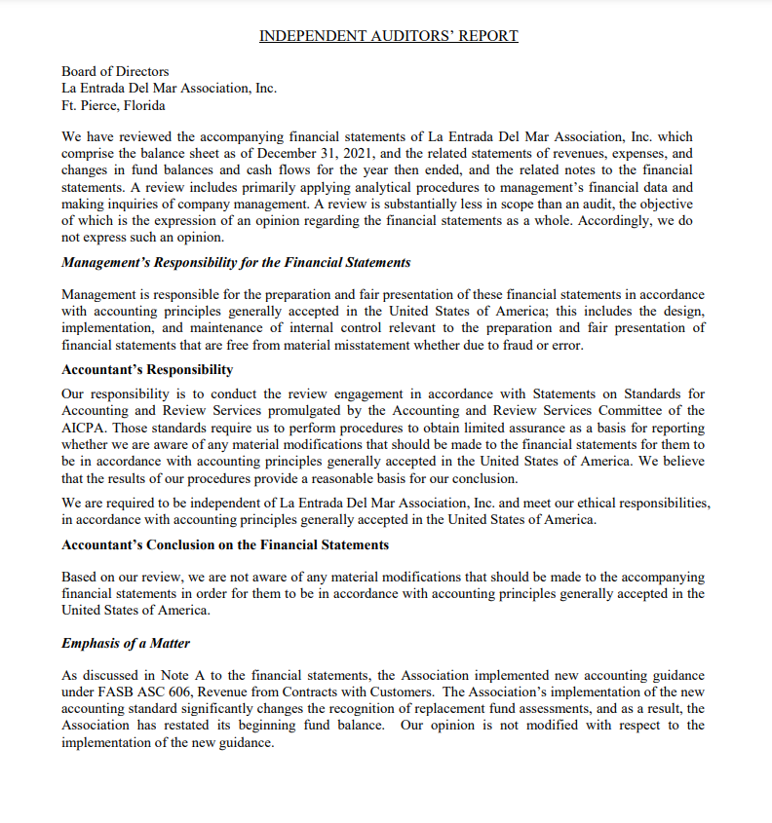
2.

Slide 15
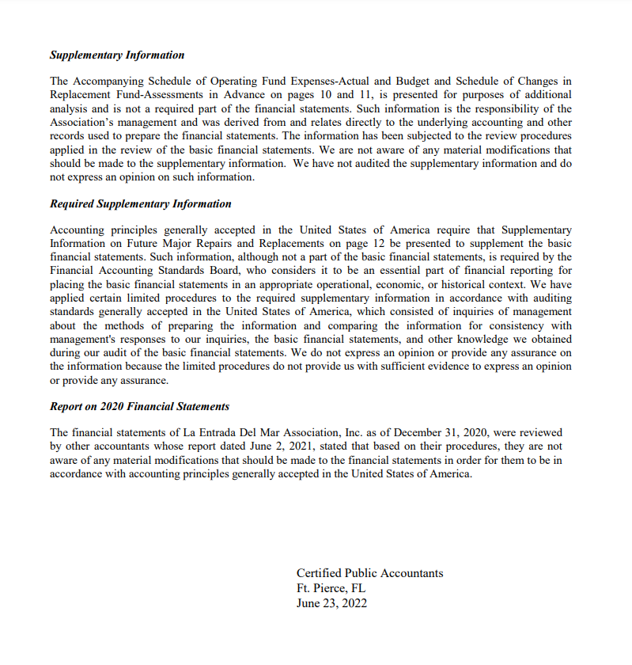
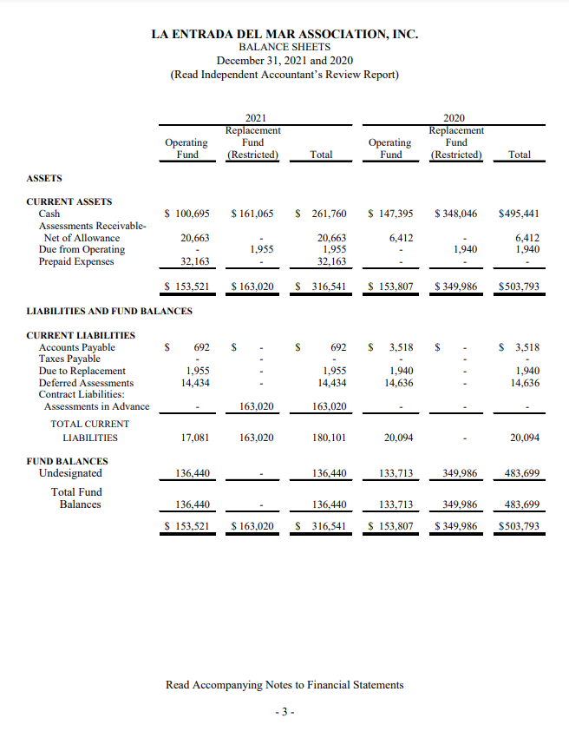

Slide 16
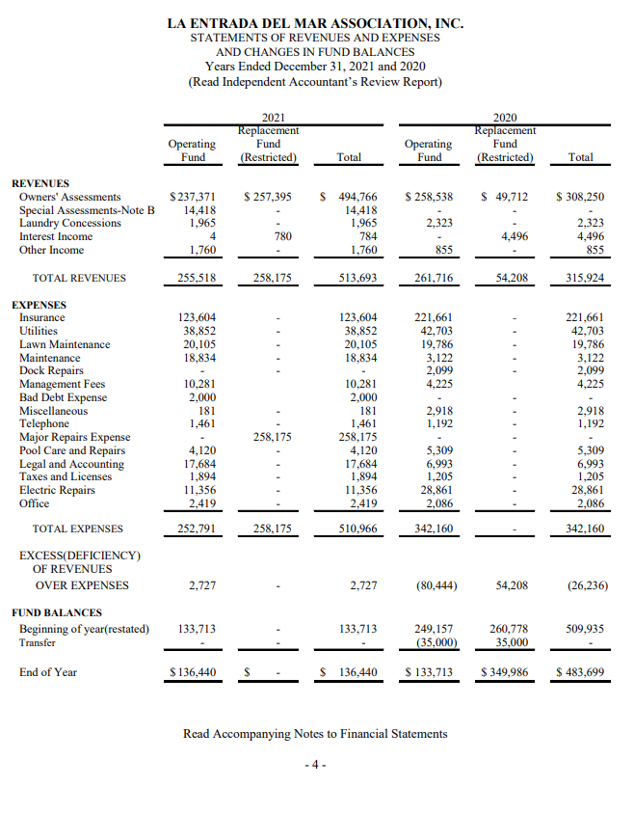
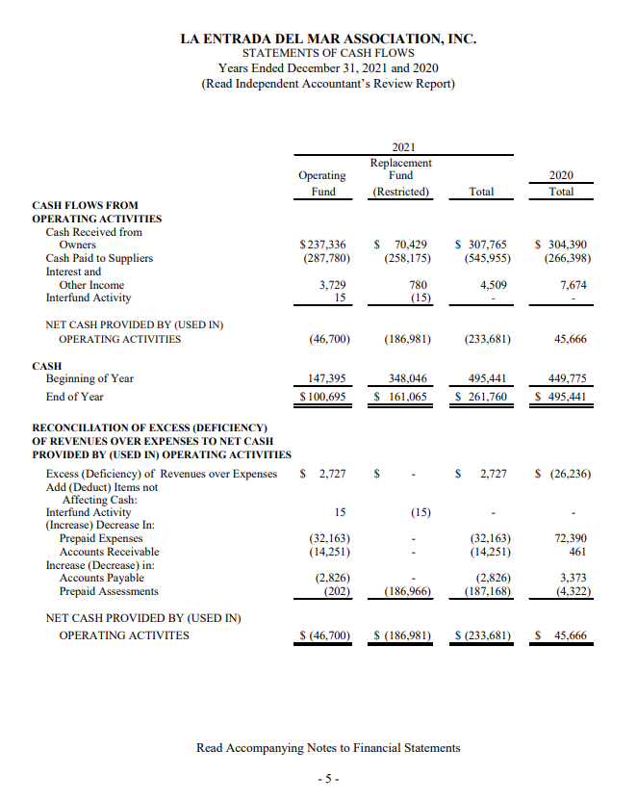

Slide 17
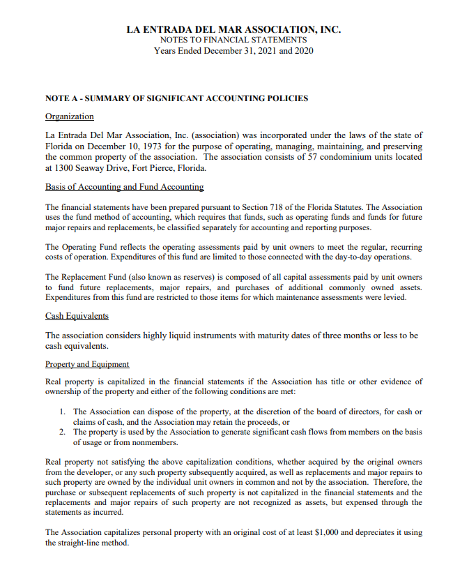
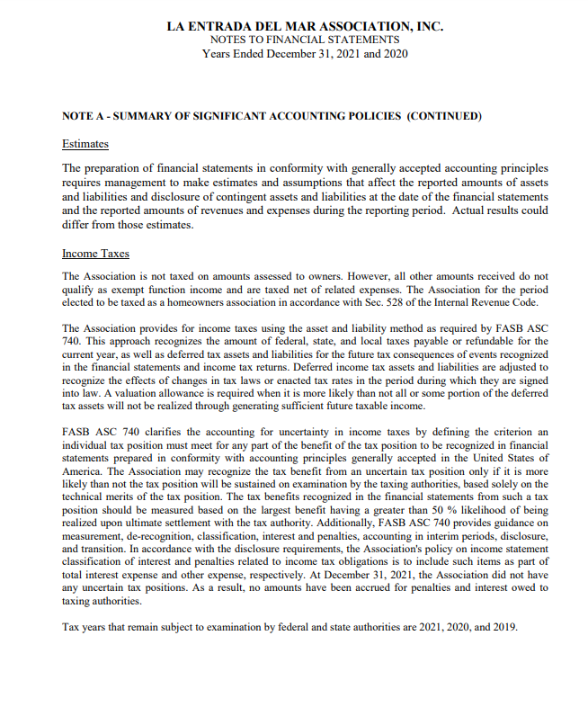

Slide 18
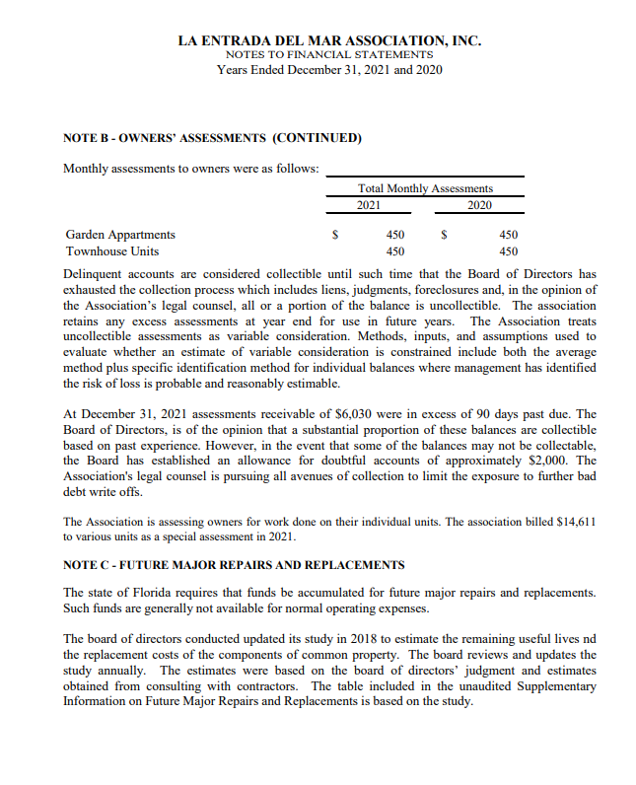
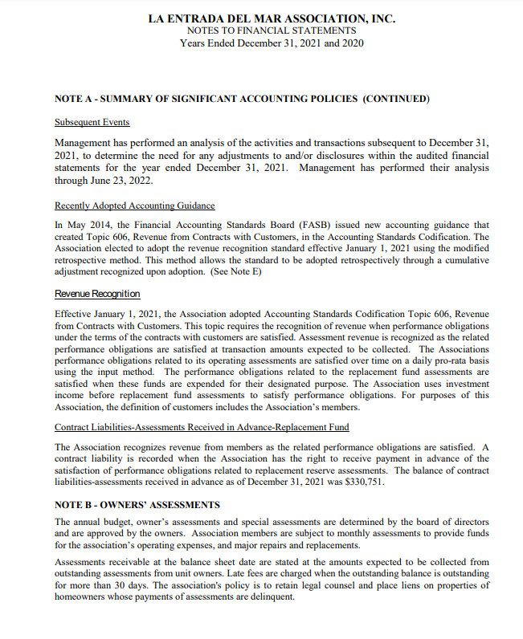

Slide 19
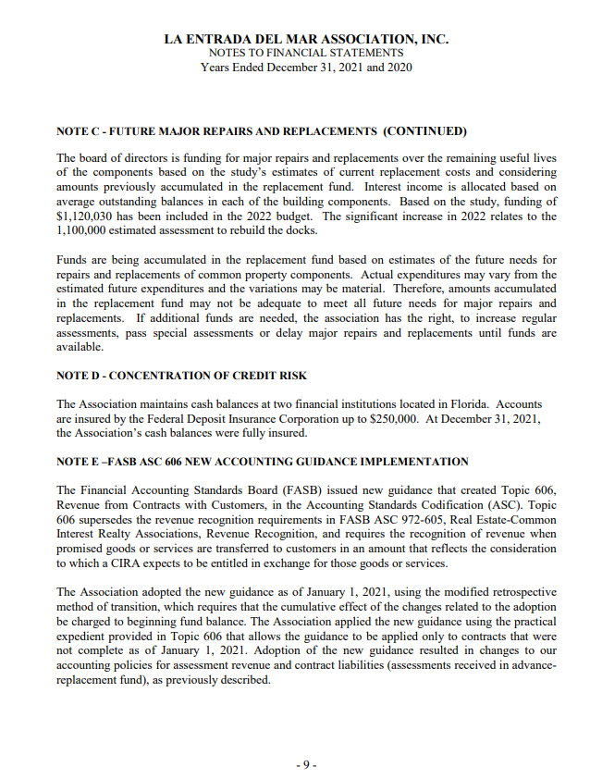
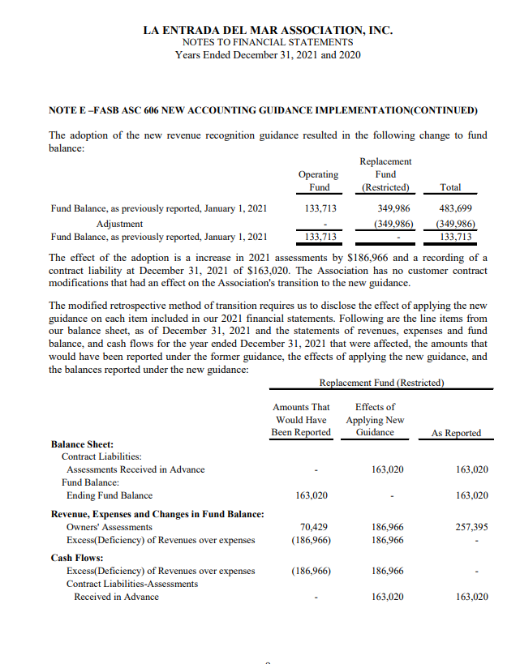

Slide 20
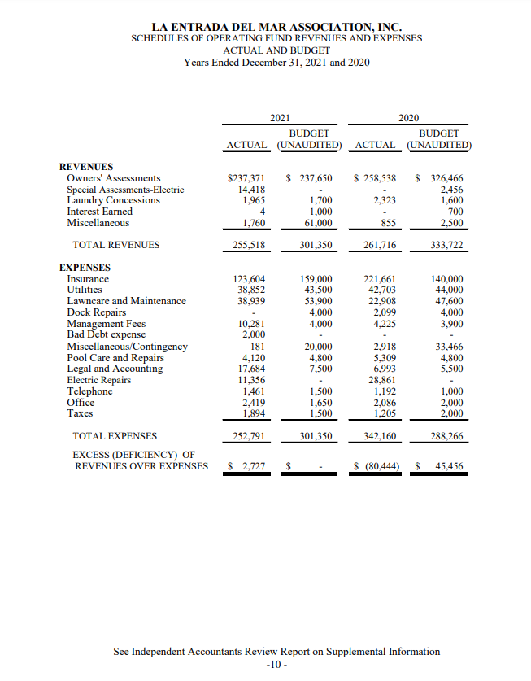
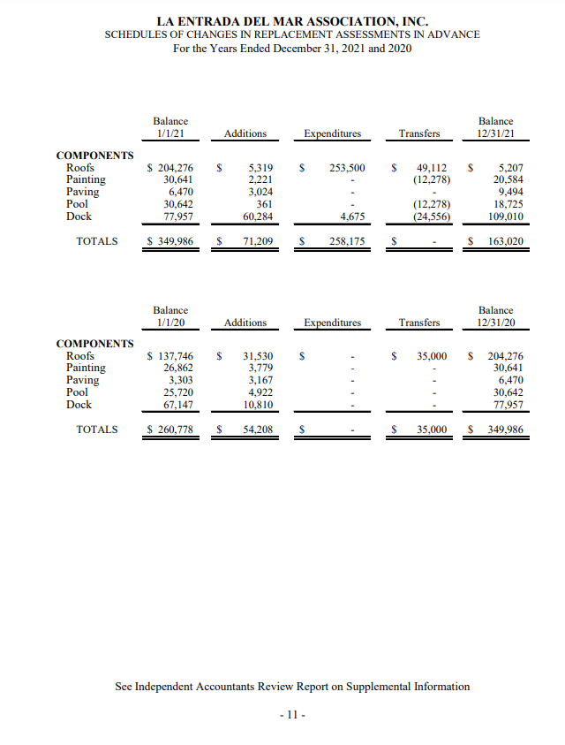

Slide 21
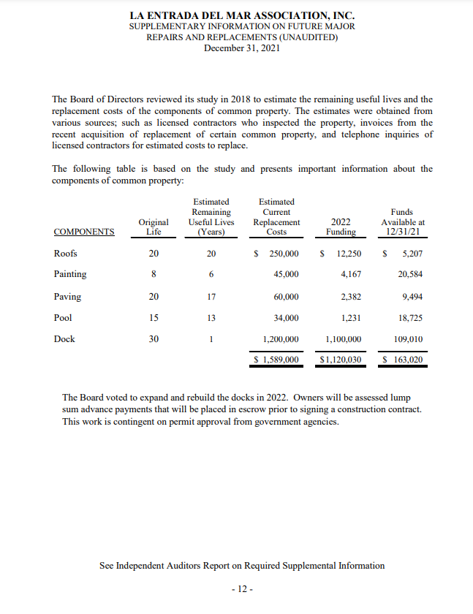

Slide 22
3.
A limited number of Rules and Regulations books have been printed for new owners and renters. It is available for referencing, downloading, and printing on the Association’s website

Slide 23
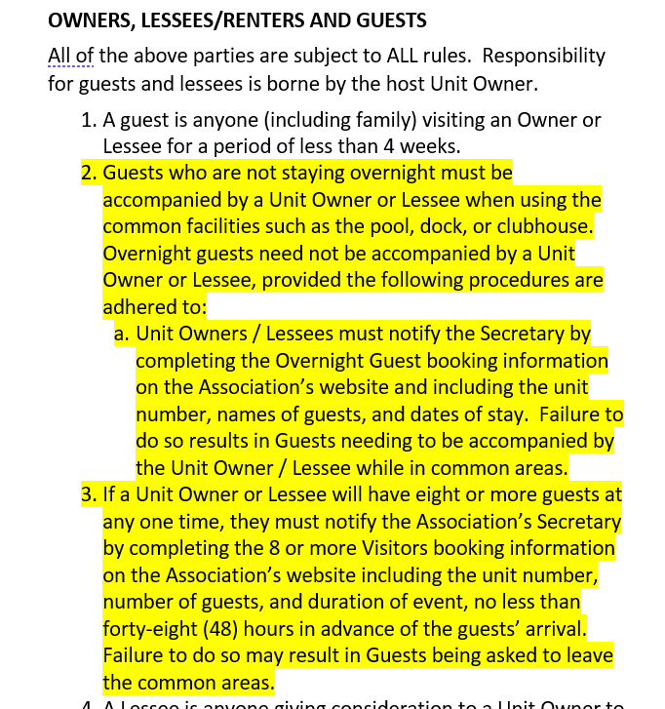
4.
From the Association’s Rules and Regulations

